Slide 1

ТBМ-Logicon
System integration
with Suppliers

Slide 2
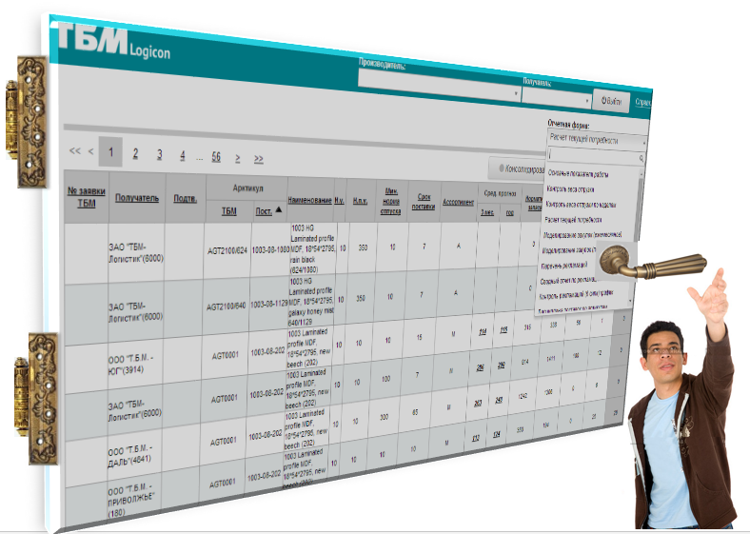
ТBМ-Logicon
Goal:
Improvement of communication with suppliers for organization of lean supply system for TBM Customers
Tasks:
To raise the transparency and reliability of the stock turnover`s system
To shorten delivery terms
To raise the service level for customers
To assist leveling processes of production
To reduce costs
Strengthening of cooperation between
TBM Company, Supplier
and Client.

Slide 3
ТBМ-Logicon. Main principles of cooperation.
ТBМ presents software product for integration
with ERP system of the Producer
The demand of goods is formed on the basis of system of «pulling»
in which Customer is the most important part
Producer gets information about demand in goods
Information about demand in goods is passed
to the producer`s system automatically
Every day Producer receives information about stock remains, forecasts of sales and purchases, delivery discipline and reclamations
Producer completes deliveries in the system which is integrated with TBM Logicon
to the address of TBM Company
and bears responsibility for correct terms of delivery.

Slide 4

ТBМ-Logicon. Supply chain due Kanban system.
We are forming the system of «pulling» in which Customer is the main part . Until the Customer «pulls» the goods, there will be no demand in production.
Order
Client
Producer
«Accept into production»
«Pulling» goods from system
Demand in production is equal to the «pulled» quantity of goods

Slide 5
ТBМ-Logicon
Complete usage of the system
Partial usage of the system
Automated data exchange
Information exchange

Slide 6
ТBМ-Logicon. Automatic data exchange.
Information system of Producer
Reasons of short deliveries and corrected delivery terms
Orders
Confirmations
Invoices
Supplier `s catalogue
TBM`s information system
There is no need for manual data input.
Uploading of the documents is automatic

Slide 7
ТBМ-Logicon. Information exchange.
1
Actual and normative stock of goods at depots
2
Calculation of the actual demands
3
Sales forecast for the Clients
4
Purchases modeling
5
Estimation of the delivery`s discipline
6
Estimation of goods quality: list of claims, 6 sigma rating
7
Control of orders and short deliveries
8
Control of delivery weight: weekly and monthly
9
VIP report – sales to the Clients
10
General report about main indicators fulfilment of system performance

Slide 8
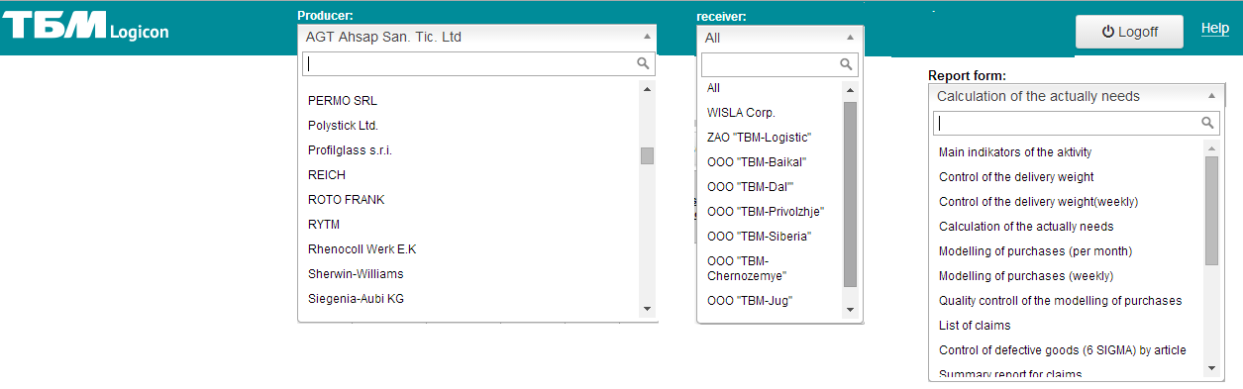
ТБМ - Logicon. Main interface.
145 of producers are included in the system
ТBМ`s divisions and subsidiaries are included in the system
The system includes 16 report forms
You can see the factual stock of TBM`s warehouses due to each supply chain

Slide 9
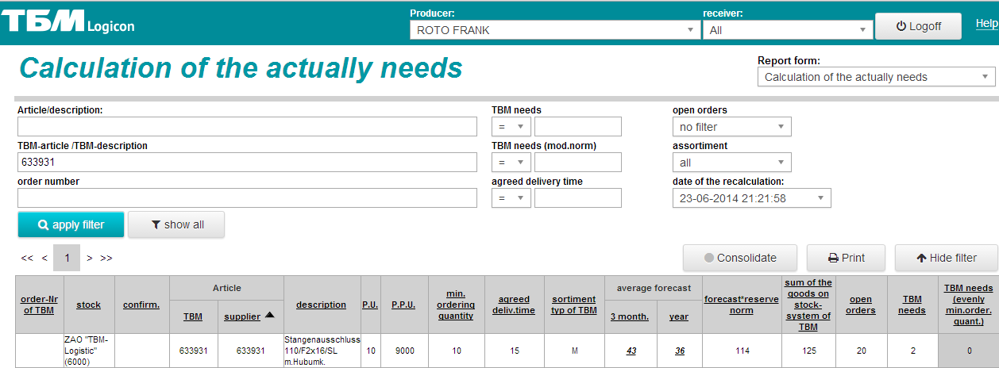



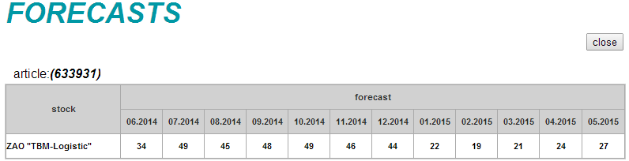
ТBМ - Logicon. Calculation of the actual needs
Sales forecast to the Clients
Every field contains important info about the state of TBM`s logistic system

Slide 10



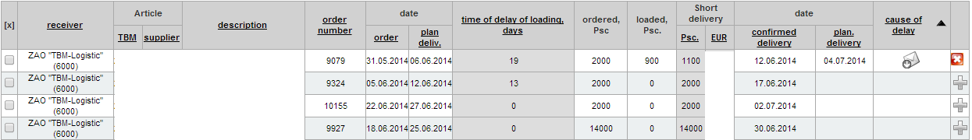
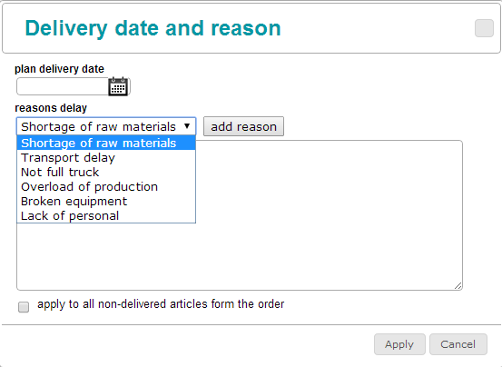
ТBМ - Logicon. Short deliveries.
The Producer can see all short - deliveries, indicate reason of delay
and correct the planned delivery date

Slide 11
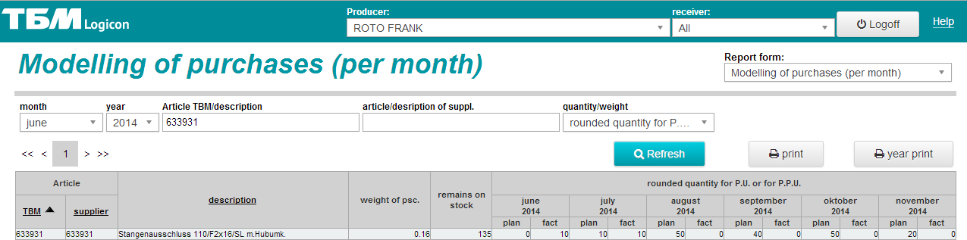
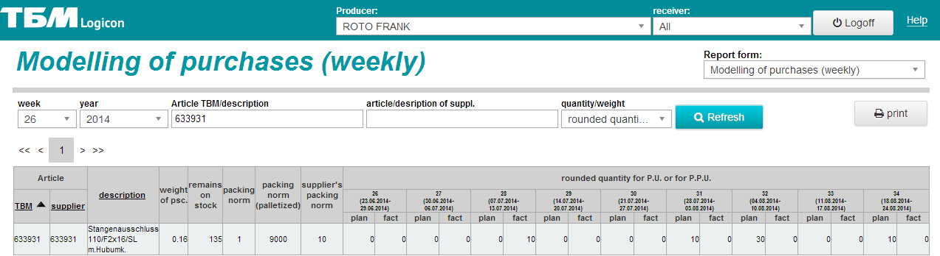
ТBМ - Logicon. Modeling of purchases
Fact – ordered
Plan – will be ordered.
Fact + Plan = Total sum of demand for week.
Purchases` forecast for 9 weeks in advance is available.
Fact – ordered
Plan – will be ordered.
Fact + Plan = Total sum of demand for week.
Purchases` forecast for 12 months in advance is available.

Slide 12
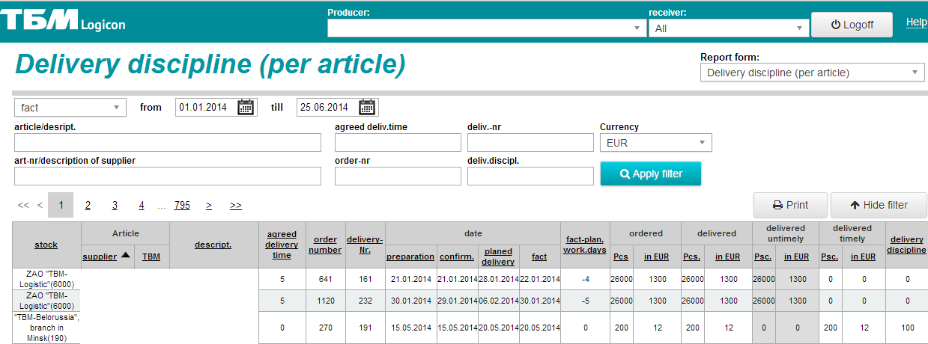
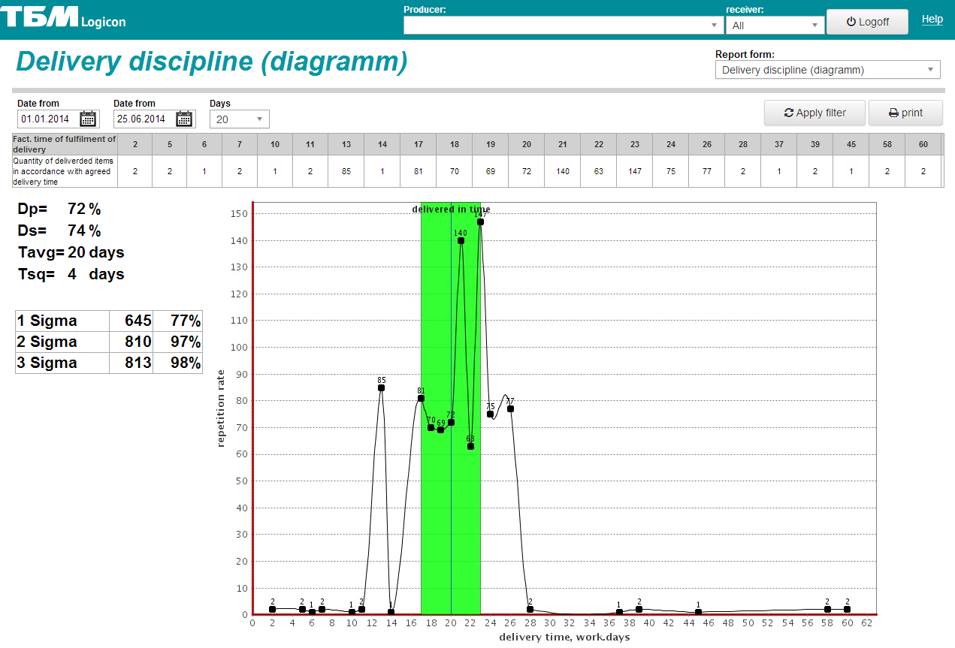
ТBМ - Logicon. Delivery discipline JIT.
You can see the calculation
and graphic display of delivery discipline per article

Slide 13
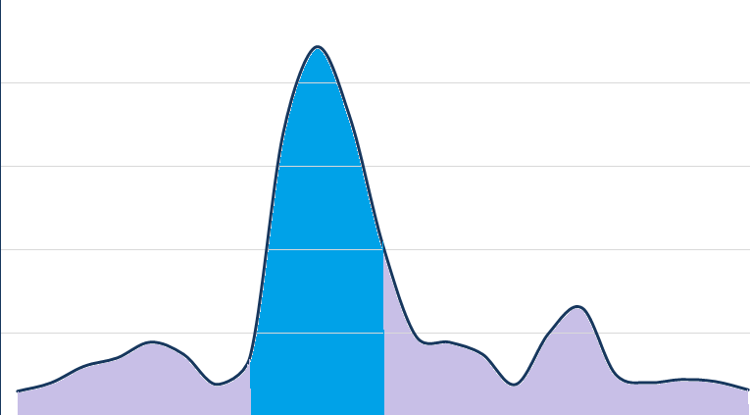
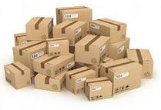
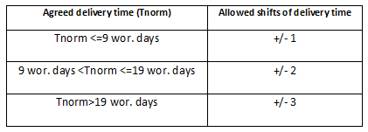
Delivery discipline JIT. Calculation principles.
Agreed delivery term
Permissible variations
NORM
uneconomical
unacceptably

Slide 14
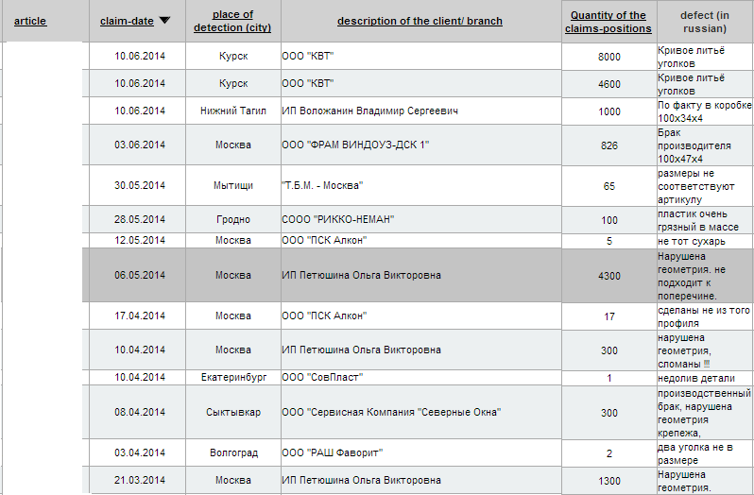
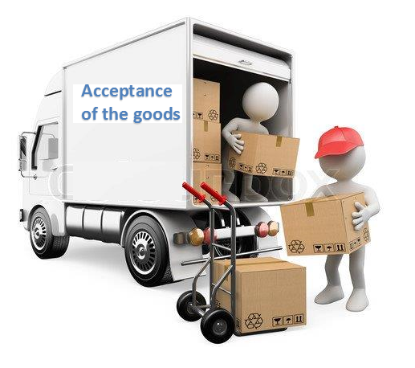




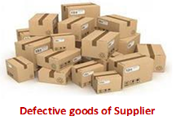
ТBМ - Logicon. Reason of the claim «Production defect».
Possibility to examine all claims of the Supplier

Slide 15
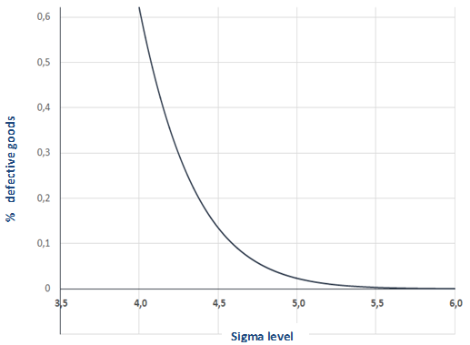
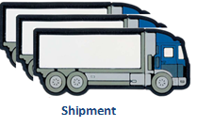
ТBМ - Logicon. Estimation due 6 sigma system. Calculation principle.
=>
Define dependence of sigma level due to number of mistakes

Slide 16







Estimation due 6 sigma system. Quality groups.
World class quality
Top quality
Good quality
Satisfactory quality
0,0003%
defective goods
≤ 0,02%
defective goods
≤ 0,14%
defective goods
≤ 0,6%
defective goods
Unsatisfactory quality
>0,6% defective goods
Quality requirements for TBM`s trade marks not less than 4,5 sigma;
other products not less than 4 sigma.

Slide 17
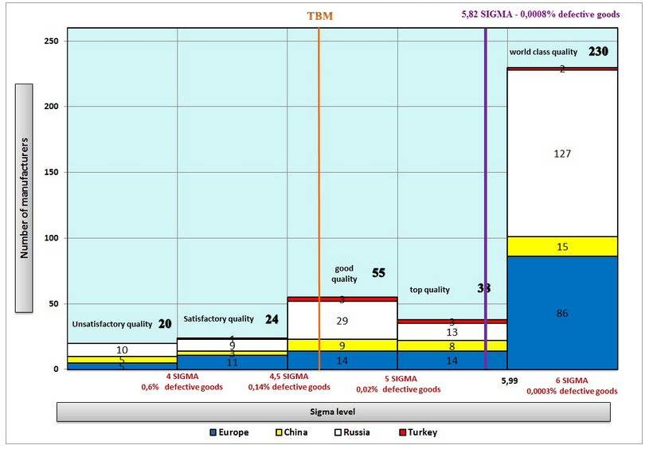
ТBМ - Logicon. Estimation due 6 sigma system.
Представлена оценка качества по системе «6 сигм» по каждому Производителю и according to all TBM`s Suppliers

Slide 18
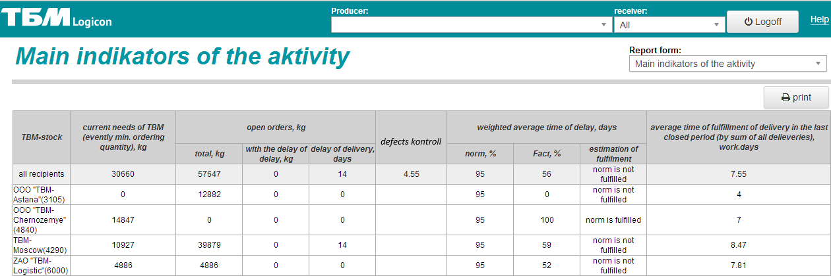
ТБМ - Logicon. Main indicators of activity.
With the help of this form you can see the report form with the main indicators of activity and estimate the quality of the work

Slide 19

ТBМ - Logicon. TRUST between partners

Slide 20

ТBМ - Logicon. Advantages for Producers
Leveling processes of production
Increase the speed and reliability of the information exchange process
Reduction of working hours for maintenance of process of supply
Producers receive on-line information on the state of the TBM`s logistics system
Increasing of customer`s service level
Improving of cooperation between our Companies
Obtaining of «dividends of high trust»
("The Speed of Trust" by Stephen M.R. Covey, Rebecca R. Merrill.)

Slide 21

ТBМ - Logicon. Advantages for Clients
Client`s demand is forwarding
to the Producer`s information system instantly
Increasing of service level
Client can see actual delivery terms
Improving of cooperation between Client, TBM and Producer
Obtaining of «dividends of high trust»

Slide 22

ТBМ - Logicon. Advantages for TBM
  The speed and reliability of the information exchange process increases
  Improvement of delivery discipline and service level for Clients
Reduction of delivery terms
Reduction of working hours for maintenance of process of supply
Improving of cooperation between Client, TBM and Producer
  Obtaining of «dividends of high trust»

Slide 23

ТBМ - Logicon. Estimation by the Producers
Information or ТBМ LOGICON`s resources pointed out by Suppliers as the most important:
Automatically uploading of the orders to the Producer`s system
Information about stock remains
Information about sales` forecast and modeling of purchases
Information about open orders

Slide 24
Thank you for Your attention!

